Slide 1
Naturally Curly
Naturally Curly
Kate Hayes

Slide 2
This is the problem
The global hair industry is worth 90 Billion dollars in 2019¹
Consumers want to know which products are right for their hair
WHY ISN’T THIS EASIER?!?!?!
www.pinterest.com%252Fbebabob73%252F%26psig%3DAOvVaw2Kms6lty88Qh0P872xlCkv%26ust%3D1567655446536827&psig=AOvVaw2Kms6lty88Qh0P872xlCkv&ust=1567655446536827
Notes:
DevaCurl
Jessicurl
Suave
ASIAM
Cantu
Shea
Kinky Curly
Not Your Mothers Naturals
Herbal Essence
Garnier

Slide 3
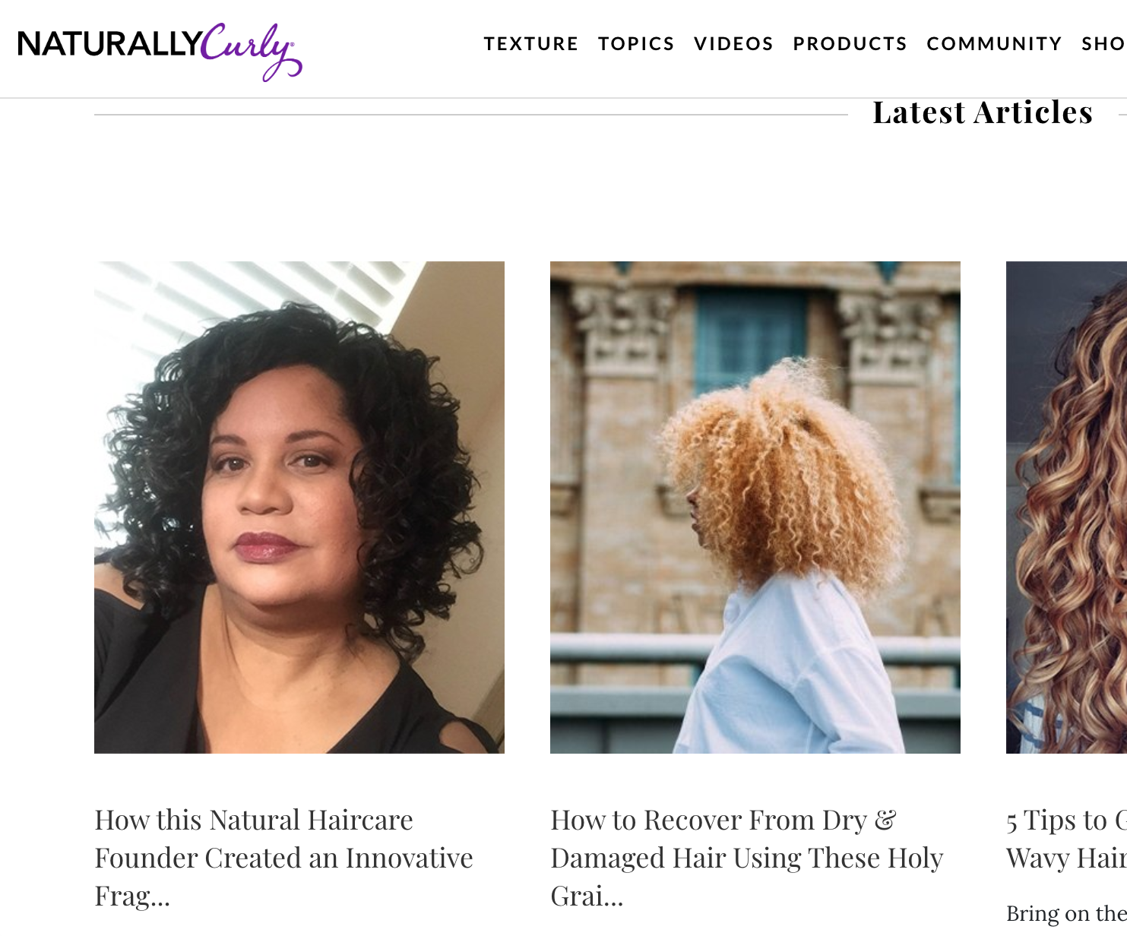

Mission: Be the most trusted & engaging community for women with textured hair.
Founded: September 1998
Offers:
expert content
qualified user-generated product and stylist reviews,
direct digital access to popular products and emerging brands

Slide 4
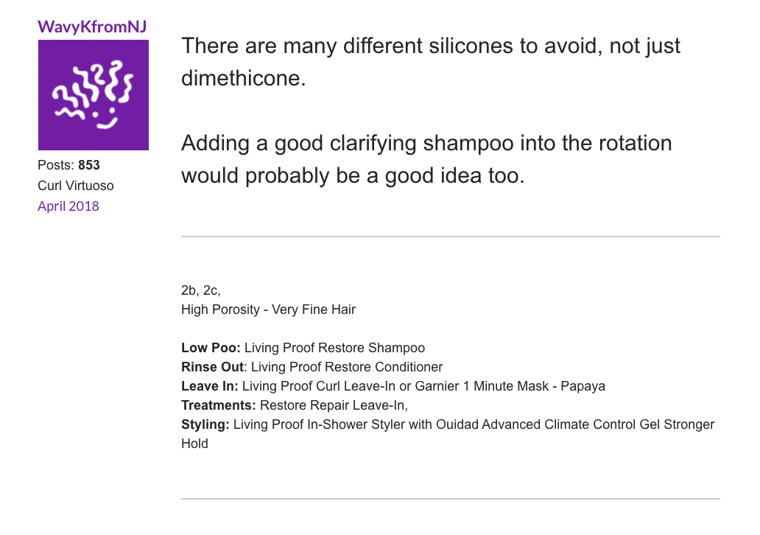
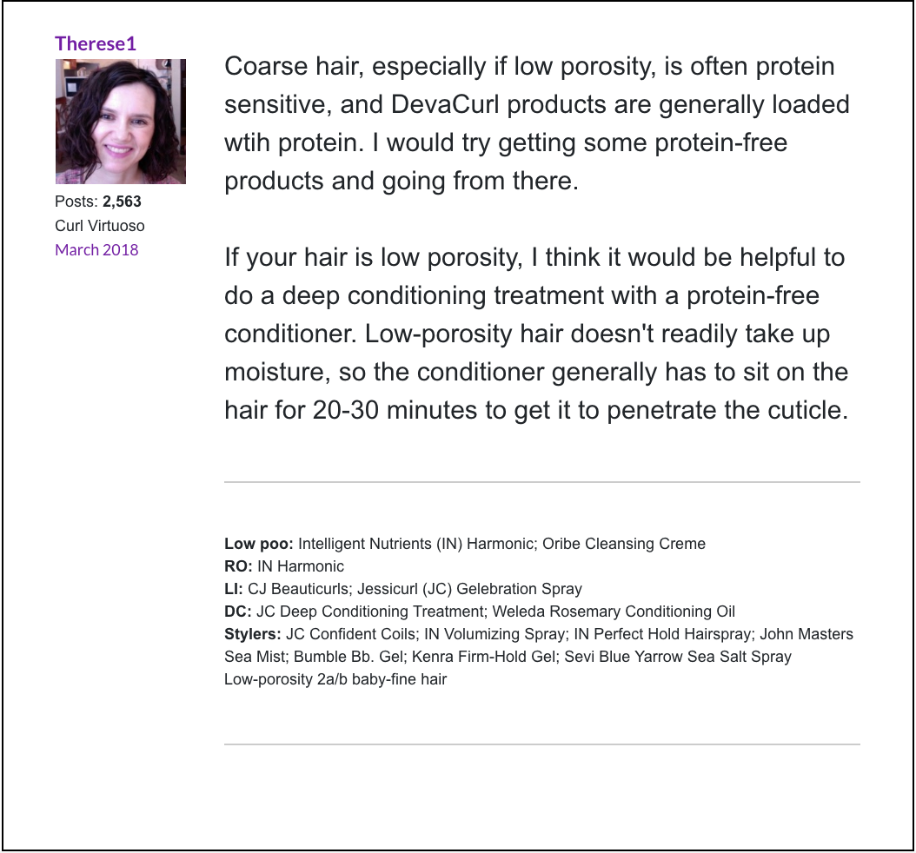
Helpful curly hair community

Slide 5
User forum signatures: hair profiles

Slide 6
User hair profile data
Hair description
Hair products

Slide 7
Hair variables
Curl Pattern
Density
How much scalp is visible
thin, medium, thick
Porosity
How much water your hair holds
Low, normal, high
Texture
How rough is the hair
Fine, medium, coarse

Slide 8
The ultimate dream
Your product drawer
Select current products
How satisfied with this product are you?
Hair data
Select curl pattern
Click to find out your recommended products!!!!
Select hair porosity
Select hair texture
Select hair density

Slide 9
First step – first modeling question
Your product drawer
Select current products
How satisfied with this product are you?
Hair data
How well do people know their hair?
Select curl pattern
Click to find out your recommended products!!!!
Select hair porosity
Select hair texture
Select hair density

Slide 10
But how well do people know their hair?!
Forum Hair Data
Machine Learning
Predict user hair characteristics from their current successful product list
Informed users can then me better decisions abut future products

Slide 11
Modeling challenges
Cleaning text data
“Mix of 3A and 3B” vs “'3b-3c”vs”3b/3c”
Addressing uneven class distributions
Creating a product dictionary
Considering context of words, not just presence
Curl Pattern | Number of Occurrences
1c | 17
2a | 314
2b | 762
2c | 1066
3a | 2019
3b | 1455
3c | 859
4a | 714
4b | 176
4c | 23

Slide 12
Approach
Heavy usage of regular expressions to clean the data up
Label and remove the four characteristics from each signature if present
Inspect various Ngrams for possible products
Perform vectorization on the product brand and use that as the feature and try to predict each characteristic category in return

Slide 13
Top Brands
Top Brands
Sauve
Shea Moisture
As I Am
Love Beauty & The Planet
Giovanni
Not Your Mothers
Tresemme
LA Looks
Herbal Essences
DevaCurl
Kinky Curly

Slide 14
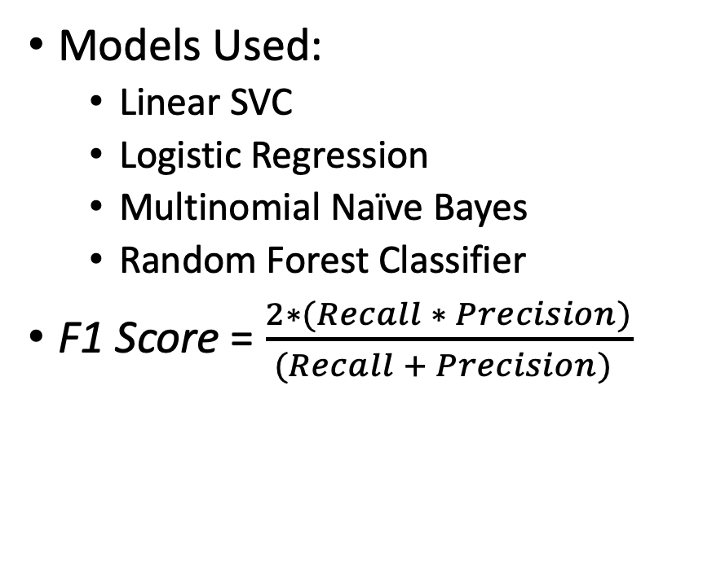
Results
Curl Characteristic Predicted | F1 - Weighted Average of Precision and Recall | Best Performing Model
Texture | 67 % | Random Forest
Density | 39 % | Logistic Regression
Porosity | 40 % | Multinomial NB
Curl Pattern | 17 % | Logistic Regression
Models Used:
Linear SVC
Logistic Regression
Multinomial Naïve Bayes
Random Forest Classifier
F1 Score = $\frac{2∗(Recall ∗ Precision)}{(Recall + Precision) }$

Slide 15
Conclusions & Future Work
Better than Random Guessing
Texture is most useful for predicting products
Tweak model parameters using a pipeline
Up-sampling or down-sampling needs to be applied to even out class imbalances, but using F1 score helps account for this
Use the full product to predict rather than just the brand
Create an app that people can use to input the products that work for them and get their probable curl characteristics and other suggested products

Slide 16
Thank You For Your Time
Questions?

